Slide 1


IDENTIFYING SYNTHETIC VIDEOS
A Deepfake Detection Approach
TEAM MEMBERS
RHITHIK S - 2022510009
DIVYA BHARATHI S - 2022510063
KARTHIKEYAN U - 2022510311
Guide:
Dr. M. R. Sumalatha
(Head of the department)
Department of Information Technology
Artificial Intelligence and Data science
Madras institute of Technology

Slide 2



How Our Project is Socially Relevant
.
Deepfake videos have become increasingly prevalent in recent years, leading to a significant rise in online misinformation and digital identity theft. These manipulated videos are used maliciously to spread false information, defame individuals, and cause public unrest. Detecting deepfakes is crucial for preserving social integrity, combating cybercrime, and protecting individuals' digital identities. Our project addresses this social issue by developing a robust system that accurately identifies synthetic videos, helping authorities and digital platforms ensure the authenticity of media content

Slide 3
Problem Statement
The primary challenge is to accurately identify synthetic videos generated using AI-based deepfake techniques. This project aims to develop a robust detection system that distinguishes between real and synthetic videos, comparing the performance of MobileNet and Multiscale Vision Transformer (MViT) models.
Objectives
·Develop an accurate and reliable system to detect synthetic videos (deepfakes).
·Compare the performance of MobileNet and MViT in terms of accuracy, precision, recall, F1-score, and AUC.
·Evaluate the efficiency of each model in real-time application scenarios.

Slide 4
Scope of the Project
Inclusion:
o Deepfake detection from video data (real and synthetic)
o Comparison of MobileNet and MViT models
Exclusion:
o Audio deepfake detection
o Real-time integration with social media platforms

Slide 5

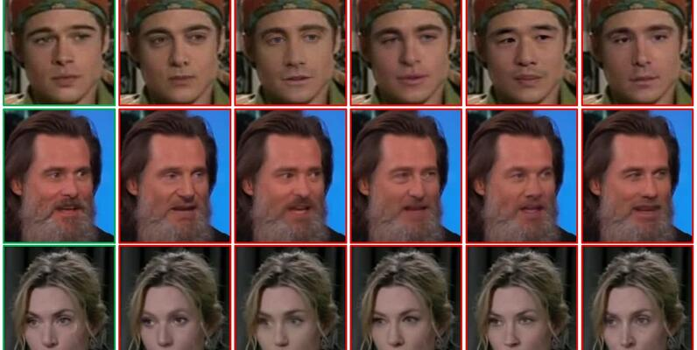
Dataset Information:
The project utilizes the Celeb-DF v2 dataset, a widely used benchmark for deepfake detection research. This dataset includes:
Total Videos: Approximately 5,639 videos
Real Videos: 890 genuine videos from celebrities
Fake Videos: 4,749 synthetic videos generated using advanced deepfake techniques
Video Quality: High resolution and realistic facial movements, making detection challenging
Dataset Features:
Realistic lip synchronization
High-quality face swapping
Minimal artifacts compared to earlier datasets
Data Format: MP4 video files categorized into real and synthetic folders

Slide 6
Literature Review
Deepfake detection is crucial due to the rise of manipulated videos.
Traditional Methods:
CNN-based frame analysis detects inconsistencies but struggles with high-quality deepfakes.
Modern Deep Learning Approaches:
MobileNet: Lightweight, efficient for real-time use, but less accurate for complex deepfakes.
MViT: High accuracy with fine-grained detection but computationally intensive.
Comparing MobileNet and MViT helps find the best model for balancing accuracy and real-time performance.

Slide 7
Proposed System Overview:
The system uses two deep learning models: MobileNet and MViT.
MobileNet:
Lightweight and suitable for real-time applications
Lower accuracy compared to MViT
MViT (Multiscale Vision Transformer):
Transformer-based, offering higher accuracy
Requires more computational resources
Dataset: Celeb-DF v2 (real and fake videos)
Data Processing:
Frame extraction, normalization, and data augmentation for robustness
Objective:
Compare model performance (accuracy, precision, recall, F1-score, AUC)
Determine the best model for synthetic video detection in various application contexts

Slide 8

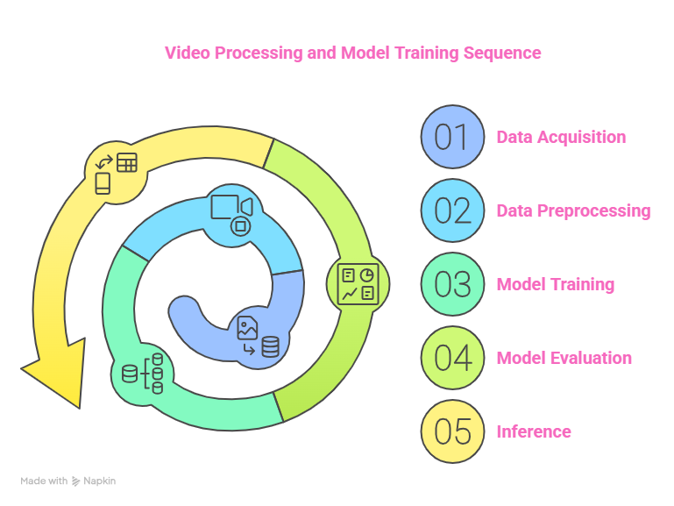
System Architecture :

Slide 9
Modules Description
·Data Collection: Gathering real and synthetic video data.
·Data Preprocessing: Frame extraction and augmentation.
·Model Training: MobileNet and MViT model training.
·Model Evaluation: Accuracy, precision, recall, F1-score, and AUC comparison.
·Inference Module: Applying trained models to detect deepfakes.

Slide 10
Technology Stack
Programming Language: Python
Libraries: PyTorch, OpenCV, TorchVision, Scikit-learn
Framework: Streamlit for app deployment
Hardware: GPU (NVIDIA Tesla V100), 32 GB RAM, 1 TB SSD

Slide 11
Implementation
MobileNet: Efficient for real-time applications, but less accurate.
MViT: High accuracy, better for detecting complex manipulations.
Data Pipeline: Video data -> Frame extraction -> Model input
Comparison: MobileNet (Accuracy: 73.04%, AUC: 0.6049) vs. MViT (Accuracy: 77.88%, AUC: 0.7931)

Slide 12

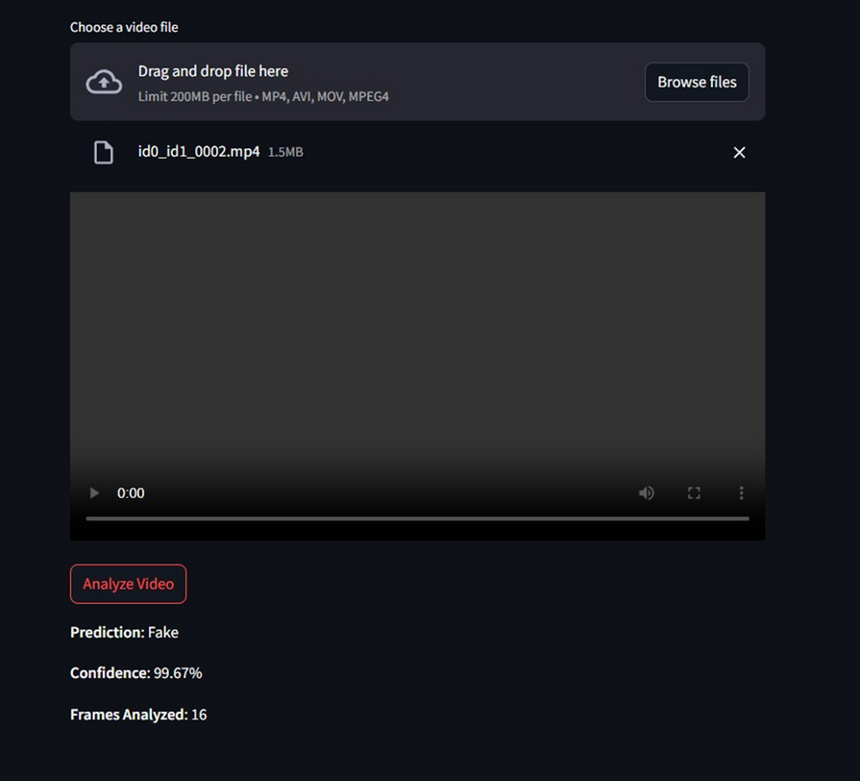
Project Demo

Slide 13
Testing
·Unit Testing: Validating frame extraction and augmentation.
·Integration Testing: Ensuring model and data pipeline compatibility.
·Performance Testing: Evaluating model accuracy and processing speed.

Slide 14
Results and Analysis
·MobileNet Results:
o Accuracy: 73.04%
o AUC: 0.6049
·MViT Results:
o Accuracy: 77.88%
o AUC: 0.7931
·Analysis: MViT shows better performance due to its transformer architecture, especially in capturing subtle manipulations.

Slide 15
Limitations & Future Enhancements
·Limitations:
o MobileNet’s lower accuracy
o High computational demand of MViT
·Future Enhancements:
o Integrating ensemble models
o Exploring real-time deployment using optimized versions

Slide 16
Conclusion:
The project successfully demonstrates the effectiveness of MViT over MobileNet in deepfake detection. While MobileNet is computationally efficient, it falls short in accuracy, making MViT a preferable choice for critical applications.

Slide 17
Q & A
ANY QUESTIONS??

Slide 18
THANK YOU

